Slide 1
Big Data Programming Spark Streaming
Module 2- Lecture 4

Slide 2
What is Streaming?
Data Streaming is a technique for transferring data so that it can be processed as a steady and continuous stream.
Streaming technologies are becoming increasingly important with the growth of the Internet.

Slide 3
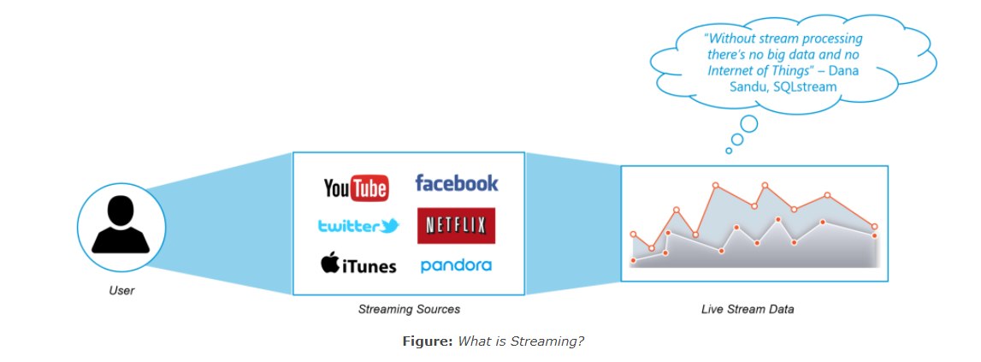

Slide 4
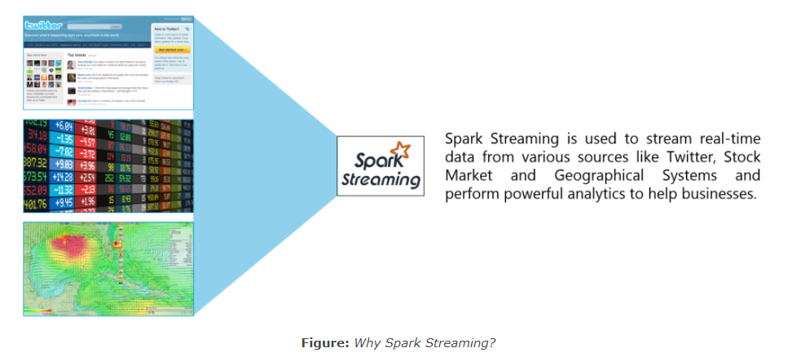
Why Spark Streaming?

Slide 5
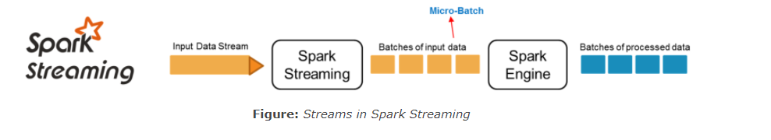

Slide 6
Spark Streaming Features
Scaling: Spark Streaming can easily scale to hundreds of nodes.
Speed: It achieves low latency.
Fault Tolerance: Spark has the ability to efficiently recover from failures.
Integration: Spark integrates with batch and real-time processing.
Business Analysis: Spark Streaming is used to track the behavior of customers which can be used in business analysis

Slide 7
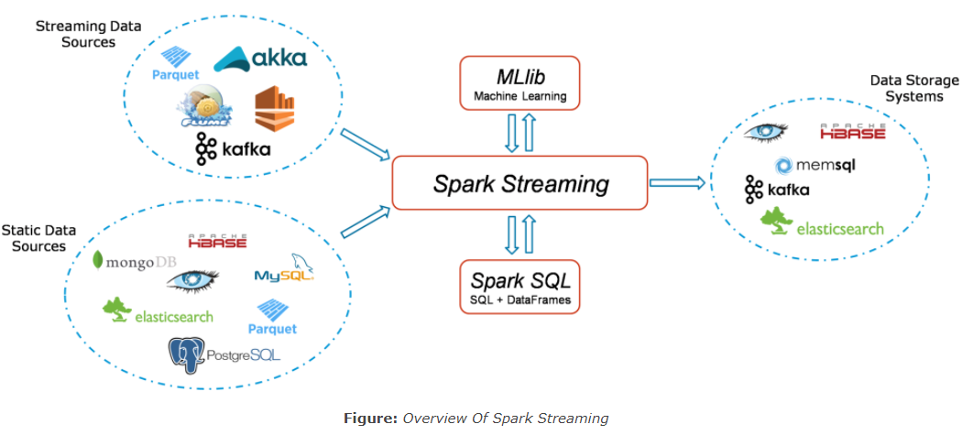
Spark Streaming Workflow

Slide 8
Spark Streaming Fundamentals
Streaming Context
DStream
Caching
Accumulators, Broadcast Variables and Checkpoints

Slide 9
Streaming Context
Streaming Context consumes a stream of data in Spark.
It registers an Input DStream to produce a Receiver object.
It is the main entry point for Spark functionality.
Spark provides a number of default implementations of sources like Twitter, Akka Actor and ZeroMQ that are accessible from the context.

Slide 10
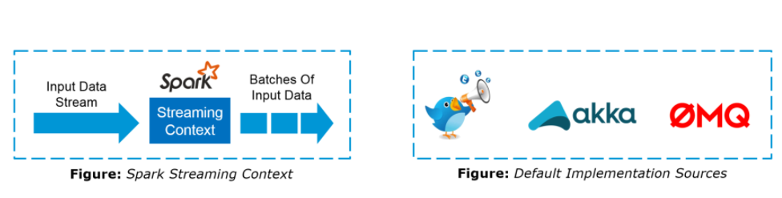

Slide 11
DStream
Discretized Stream (DStream) is the basic abstraction provided by Spark Streaming.
It is a continuous stream of data.
It is received from a data source or a processed data stream generated by transforming the input stream.

Slide 12
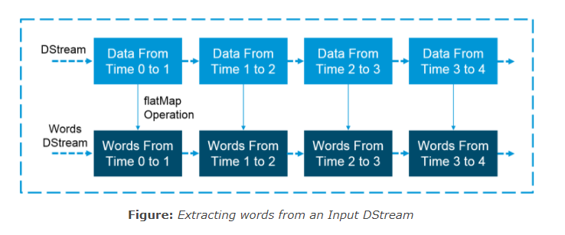

Slide 13
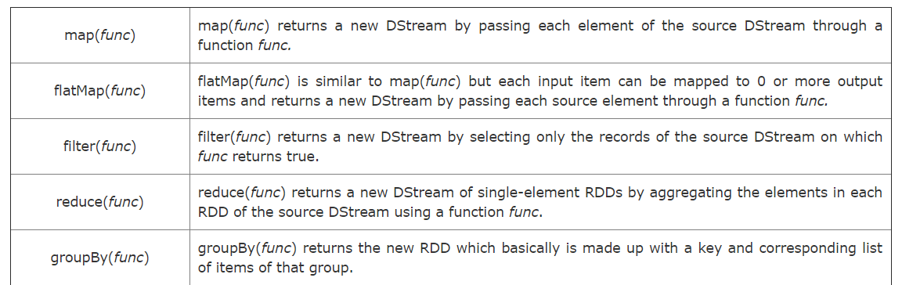
Transformations on DStreams

Slide 14
Accumulators, Broadcast Variables and Checkpoints
Accumulators:
Accumulators are variables that are only added through an associative and commutative operation.
They are used to implement counters or sums. Tracking accumulators in the UI can be useful for understanding the progress of running stages.
Spark natively supports numeric accumulators. We can create named or unnamed accumulators.

Slide 15
Broadcast Variables:
Broadcast variables allow the programmer to keep a read-only variable cached on each machine rather than shipping a copy of it with tasks.
They can be used to give every node a copy of a large input dataset in an efficient manner.
Spark also attempts to distribute broadcast variables using efficient broadcast algorithms to reduce communication cost.

Slide 16
Checkpoints: Checkpoints are similar to checkpoints in gaming. They make it run 24/7 and make it resilient to failures unrelated to the application logic.

Slide 17
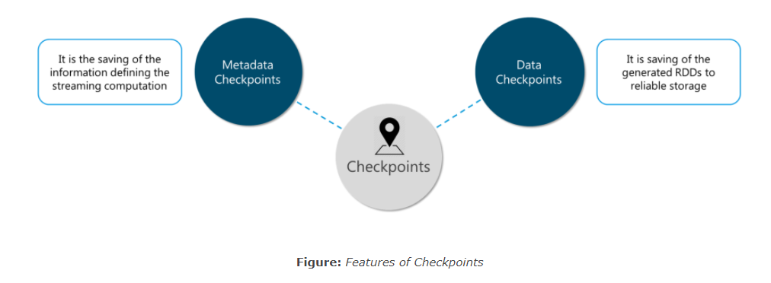

Slide 18
In Class Exercise - Part 1

Slide 19
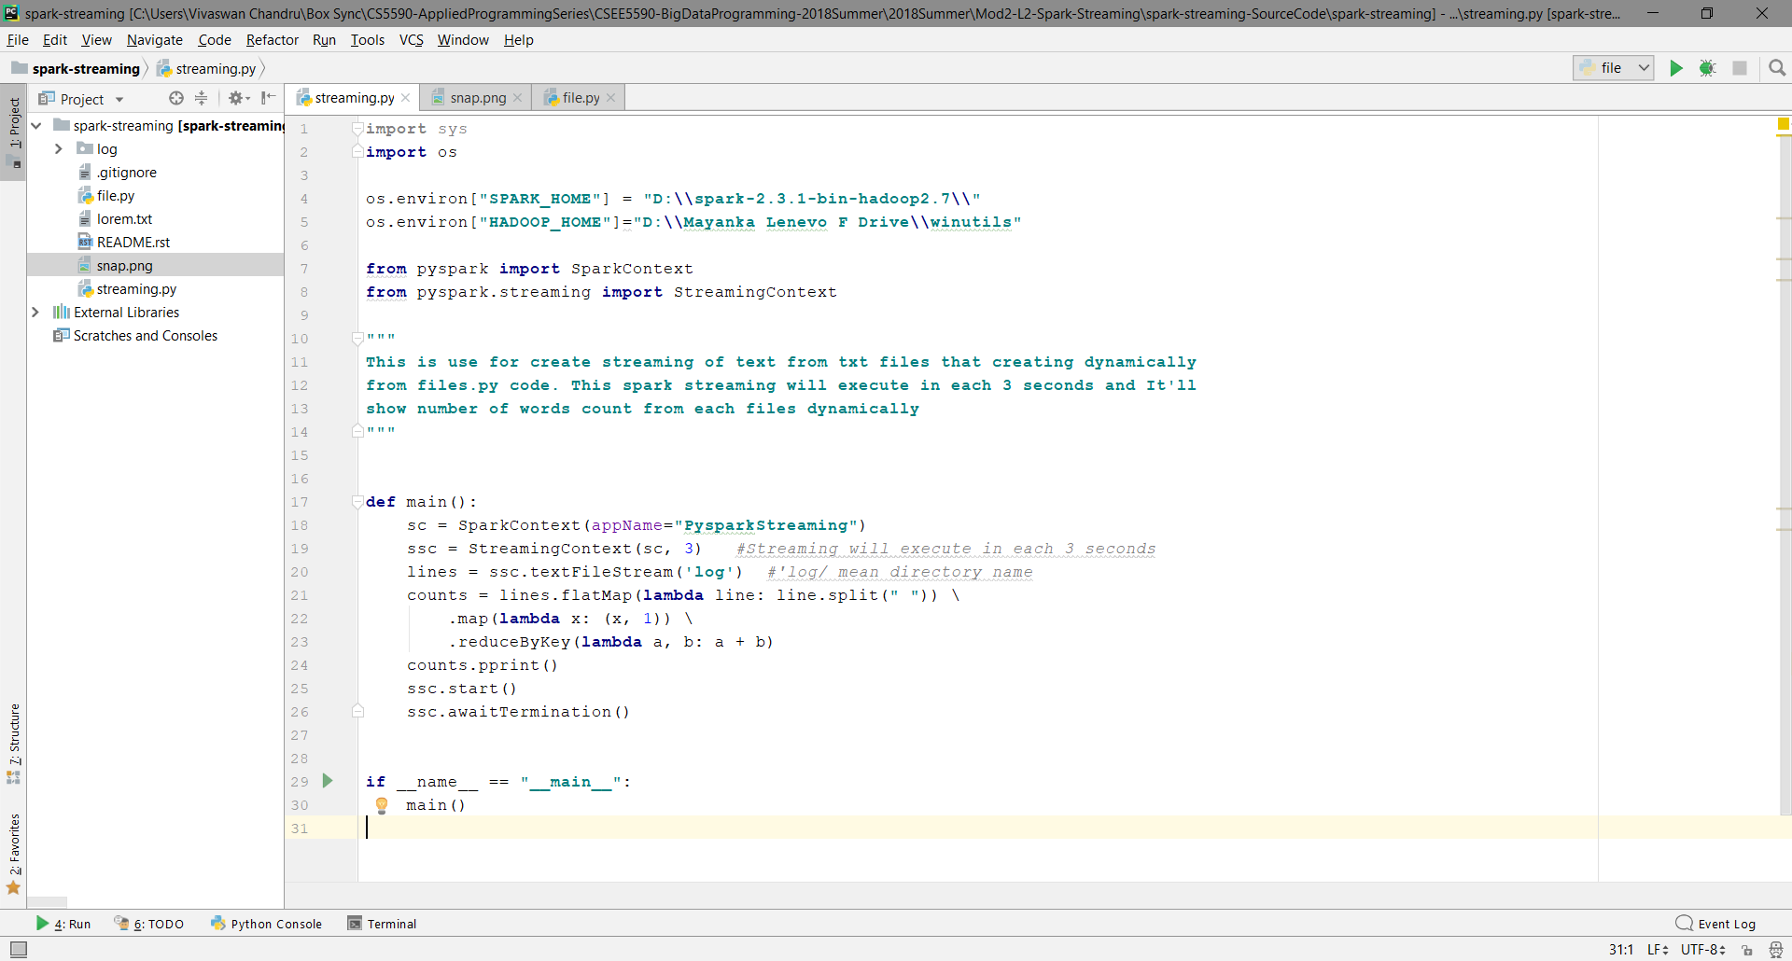
Spark Streaming
StreamingContext

Slide 20
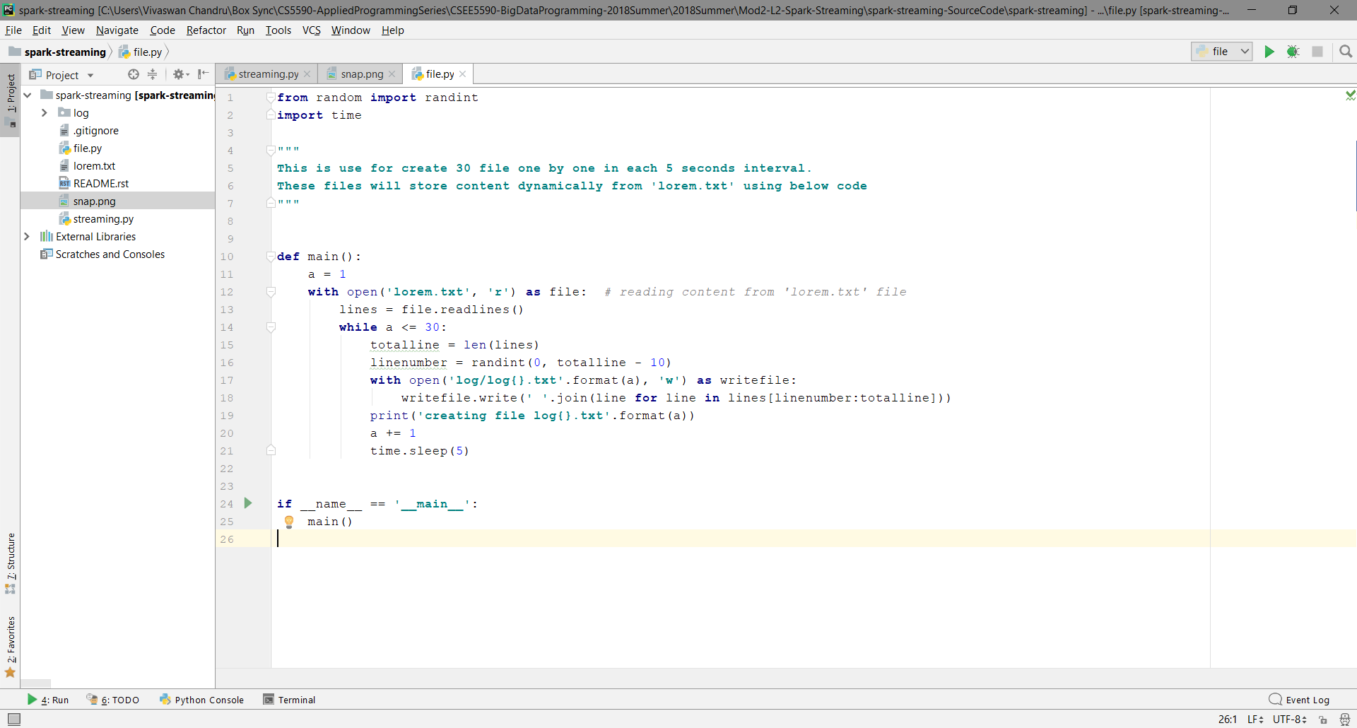
File Generation

Slide 21
Download Netcat
Go https://joncraton.org/files/nc111nt.zip
Unzip the files and use nc as password
Go to environment variables
Select Path and Add new path as you location to netcat folder.
Open command line
Type nc to check either netcat is working or not

Slide 22
Steps to Run
For PySpark
Step 1: Run files.py
Step 2: Run streaming.py
For Scala
Step 1: Run networkwordcount.scala
Step 2: Open cmd and type nc –l –p port number

Slide 23
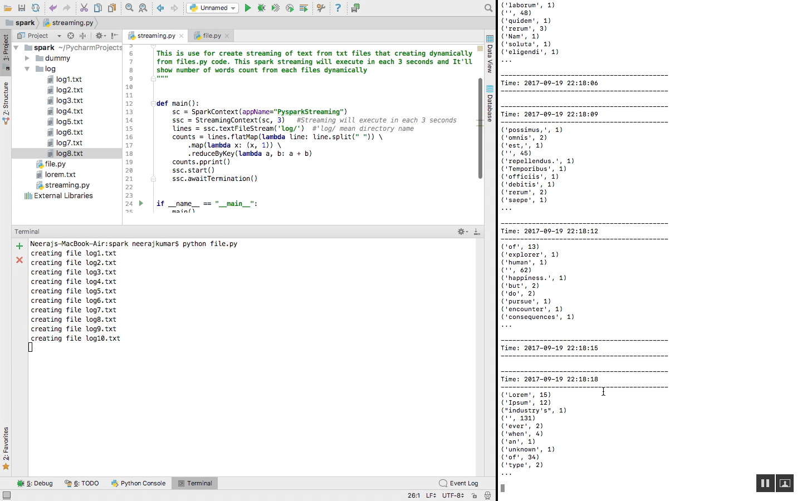
Running Results

Slide 24
In Class Exercise - Part 2

Slide 25
Spark Streaming for TCP Socket:
Write a spark word count program of Spark Streaming received from a data server listening on a TCP socket.
Hint: For Netcat utility in Windows
https://github.com/rsanchez-wsu/jfiles/wiki/Windows-10-Telnet-&-NetCat

Slide 26
Clue
NETCAT Windows Command:
nc –l –p <port number>
NETCAT Error:
Write a Python Socket Server in place of netcat.
https://umkc.box.com/s/gg5xy77kaepawu3ewelzqojyjjg7fe2e

Slide 27
References
https://spark.apache.org/docs/2.2.0/streaming-programming-guide.html
https://www.edureka.co/blog/spark-streaming/

